Slide 1
Interface
Android app is developed as the interface as it is user friendly and convenient for the users.
Google's FireBase server is used to store patient data and to communicate between app and system.
After the user enters the patient data in the app it gets uploaded to the server.
A python script is fired on the other end which retrieves the data.

Slide 2
Now using the retrieved input set it predicts the class of LOS. The 2 main classes are less than 6 days and more than 6 days.
If the prediction result is less than 6 days it will predict the probability of the patient staying each day from day 2 to day 6.
After the result is generated it is uploaded on the firebase server.
The app will retrieve that result and display on the predictions activity of the app.

Slide 3
Screenshots
The first screenshot is the activity where user can enter the patient data.
After providing appropriate data the user just have to click 'Done' button and everything will be uploaded to the firebase server.

Slide 4
The second screenshot is of the prediction activity after clicking 'Done', the user will be redirected on this page.
When the results are fetched , they will be displayed in the format visible in the screenshot.

Slide 5
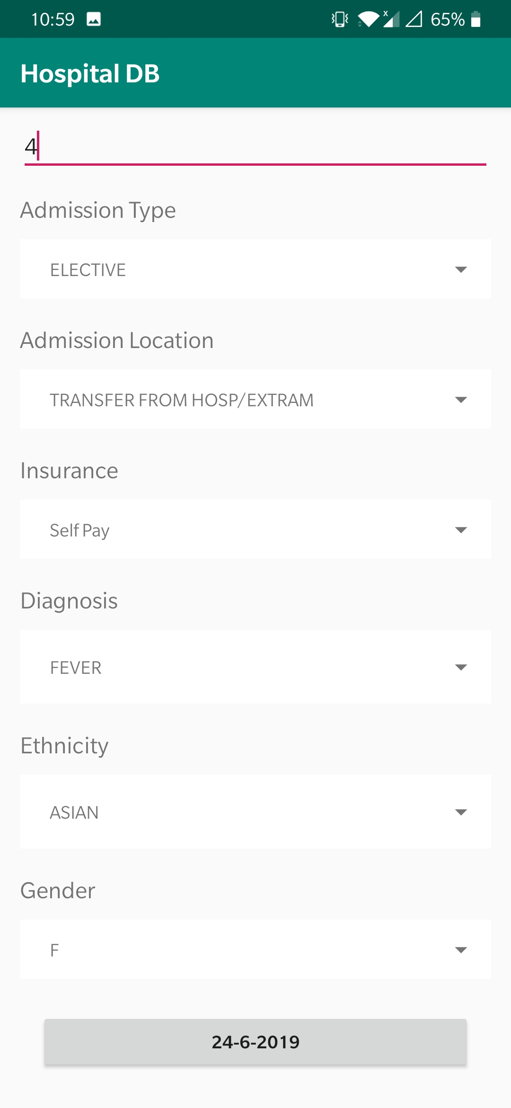
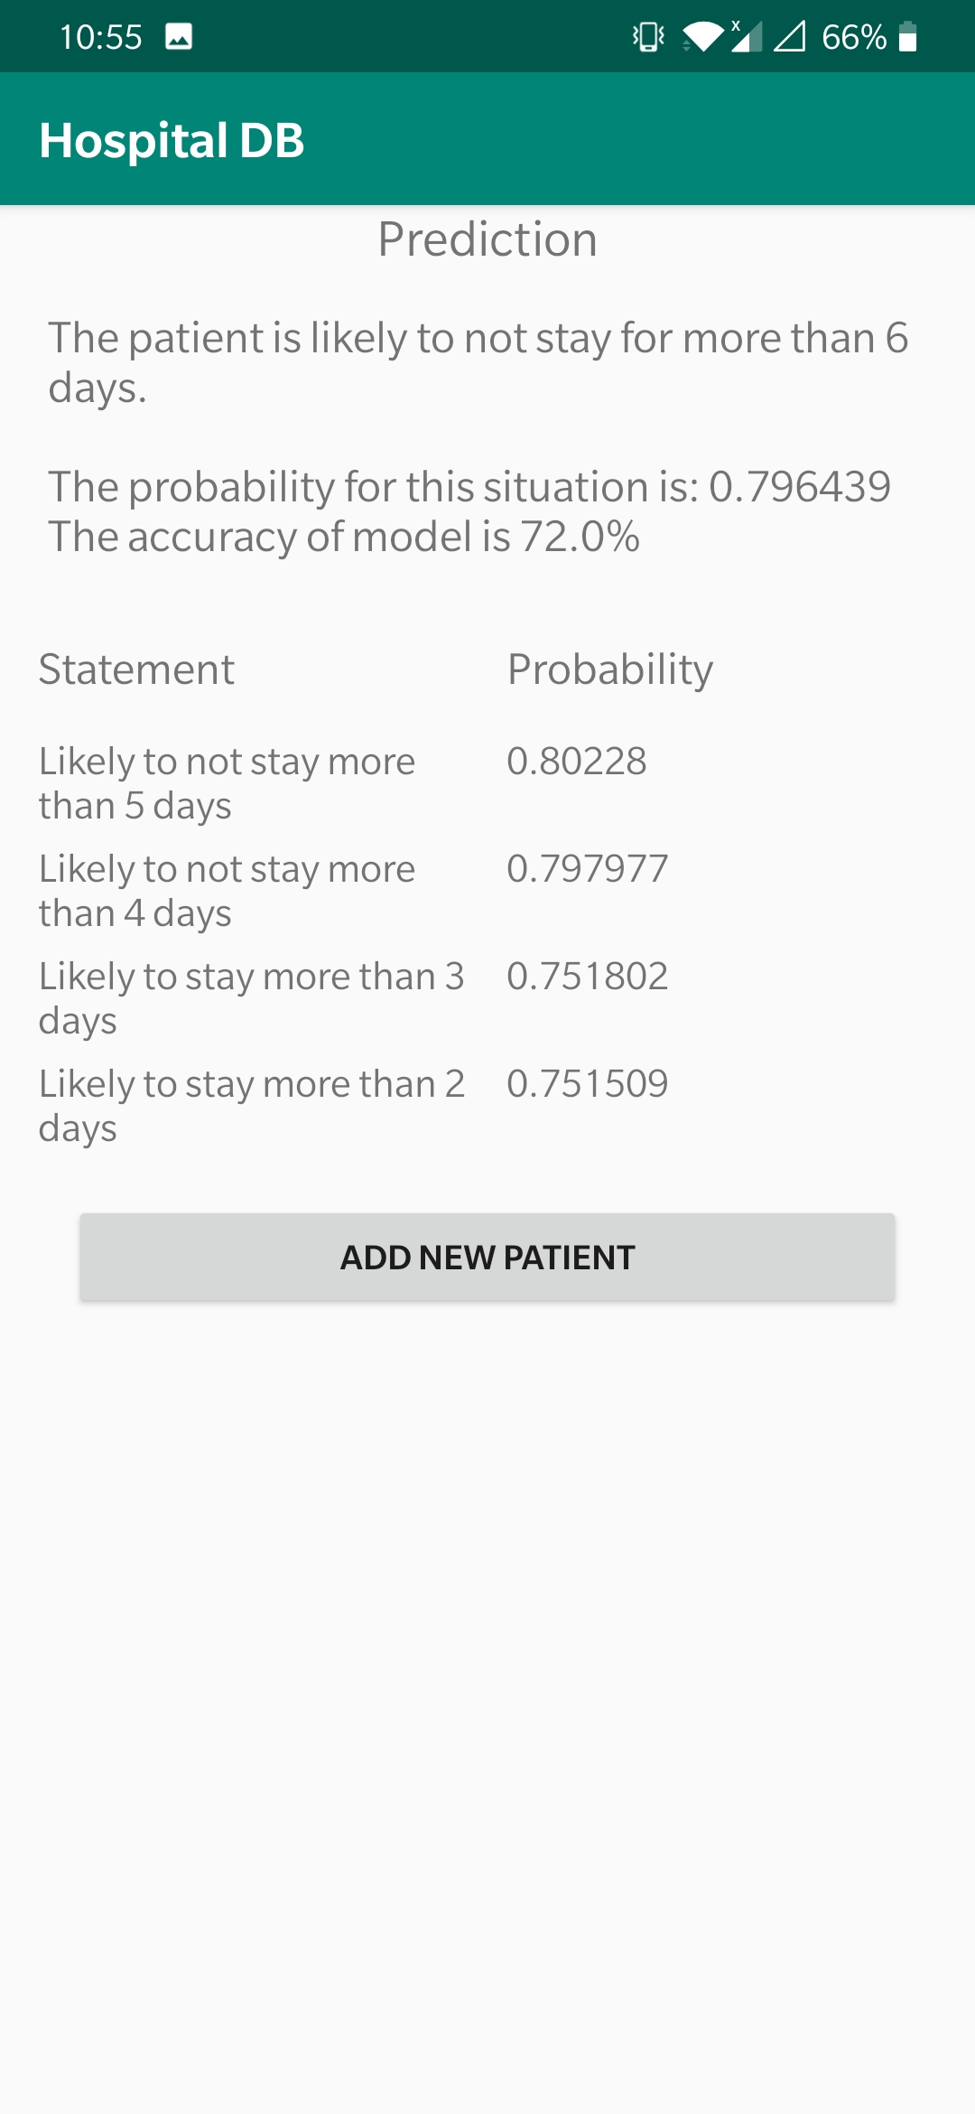
Screenshots

Slide 6
Test Cases
To test the product we made 4 test cases, which has different values for every attribute.
After entering the patient data in the app, it will show the length of stay (LOS) of that particular patient.
If LOS is less than 6, the output will show probability of that patient staying from day 2 to day 6.
Based on that result the hospital can make informed decisions and analyse the requirements of the patient.

Slide 7
Case 1
Following are the details of the patient :
Patient Id : 1
Admission Type : NEWBORN
Admission Location : PHYS REFERRAL/NORMAL DELI
Diagnosis : NEWBORN
Ethnicity : WHITE
Gender : FEMALE
Insurance : Private

Slide 8
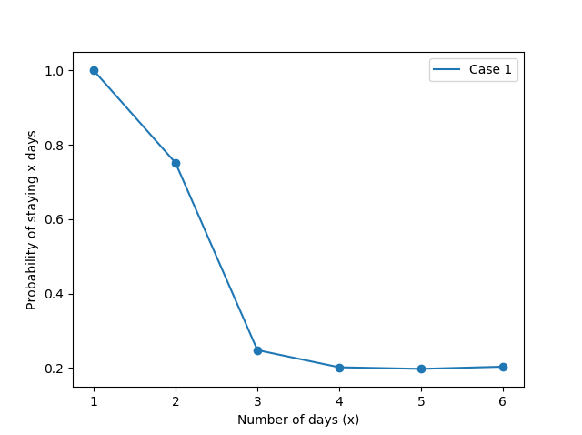
Result
In this case, it is highly likely for a patient to stay for 2 days as the probability of staying significantly decreases from day 3.

Slide 9
Case 2
Following are the details of the patient :
Patient Id : 2
Admission Type : EMERGENCY
Admission Location : EMERGENCY ROOM ADMIT
Emergency Department LOS (minutes) : 25
Diagnosis : CONGESTIVE HEART FAILURE
Ethnicity : ASIAN
Gender : MALE
Insurance : Government

Slide 10
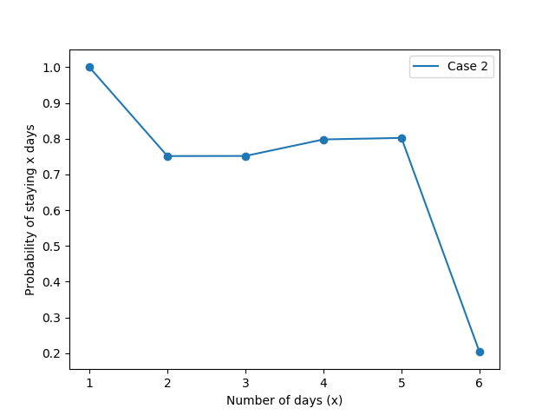
Result
In this case, it is highly likely for a patient to stay for 5 days as the probability of staying significantly decreases from day 6.

Slide 11
Case 3
Following are the details of the patient :
Patient Id : 3
Admission Type : ELECTIVE
Admission Location : TRANSFER FROM HOSP/EXTRAM
Diagnosis : PNEUMONIA
Ethnicity : WHITE
Gender : FEMALE
Insurance : Medicaid

Slide 12
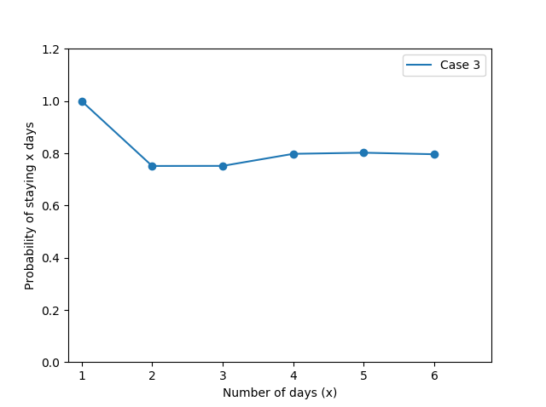
Result
In this case, it is highly likely for a patient to stay for more than 6 days.

Slide 13
Case 4
Following are the details of the patient :
Patient Id : 3
Admission Type : ELECTIVE
Admission Location : TRANSFER FROM HOSP/EXTRAM
Diagnosis : FEVER
Ethnicity : ASIAN
Gender : FEMALE
Insurance : Self Pay

Slide 14
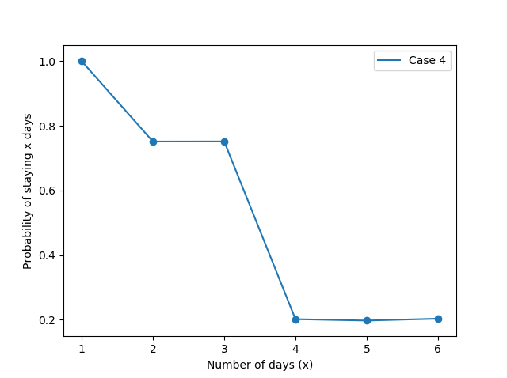
Result
In this case, it is highly likely for a patient to stay for 3 days as the probability of staying significantly decreases from day 4.

Slide 15
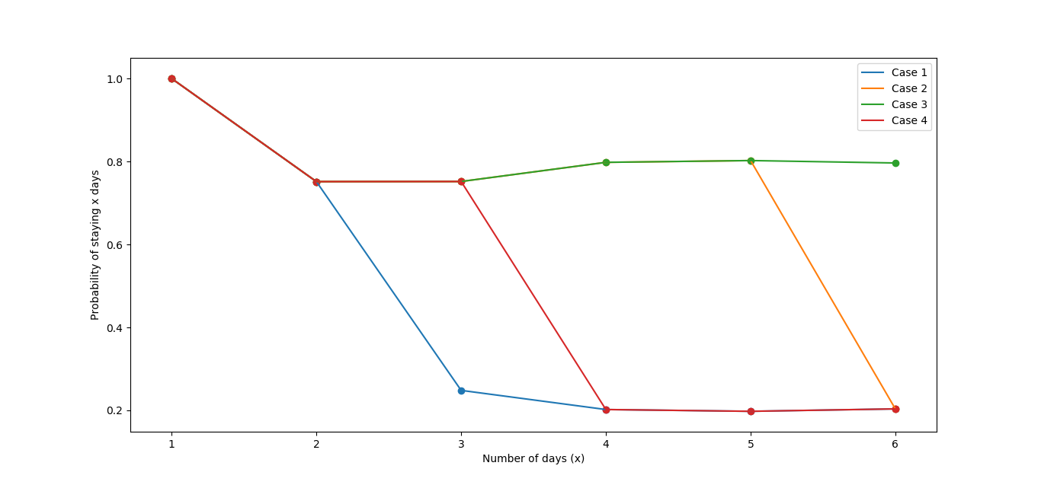
Final Result
Plotting all cases together on the same graph would give us the following result :

